Slide 1


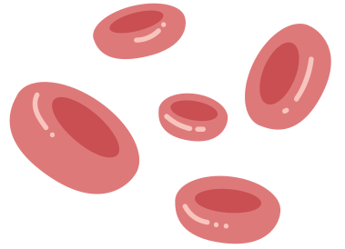
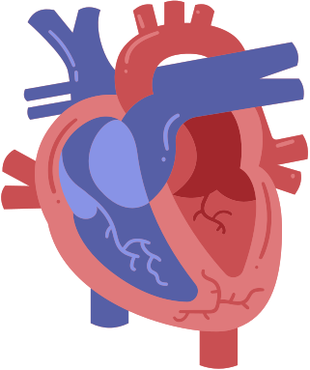


AIML PROJECT
PROJECT
TITLE-
CARDIO WATCH:Heart Disease Detection

Slide 2




PROJECT OUTCOMES :
~the outcomes could include the development of a system that can analyze
input data, such as various health parameters like cholesterol levels, blood pressure
, age, etc., and predict the likelihood of a person
having heart disease based on that data.
~The project outcomes may involve creating an AIML model that
can accurately predict the risk of heart disease for individuals.
This could help in early detection and prevention of
heart-related issues by providing insights based on the input data.
~The final outcome could be a functional heart disease
predictor tool that users can interact with to
assess their risk and take appropriate actions for their health.

Slide 3




PROJECT FEASIBILITY ANSLYSIS
In project feasibility analysis, we will assess whether our heart disease predictor project is viable and worth pursuing. We will consider factors like technical feasibility (can we build the system with AIML?), economic feasibility (costs vs. benefits), operational feasibility (how will it be used?), and schedule feasibility (timeline for completion). We need to evaluate if we have the necessary resources, skills, and support to complete the project successfully. Conducting a feasibility analysis will help us determine if our project is achievable and aligns with our goals. Excited to see the potential impact of our heart disease predictor project
left atrium
right atrium
right ventricle
left ventricle

Slide 4
ORIENTED WITH SOCIAL NEEDS
After conducting the feasibility analysis, if our heart disease predictor project is aligned with social needs, it means that the project is designed to address important health issues within society. It indicates that our project aims to provide a solution that directly benefits the community by focusing on improving the detection and management of heart disease.
By incorporating features that cater to social needs, such as accessibility, affordability, and accuracy in predicting heart disease, our project can effectively serve a broader population. This approach ensures that the project is not only technically feasible but also socially impactful, contributing to the well-being of individuals and communities affected by heart-related conditions.
Considering social needs in the design and implementation of our heart disease predictor can enhance its relevance and acceptance among users, healthcare professionals, and policymakers. It demonstrates our commitment to creating a solution that addresses real-world health challenges and promotes better health outcomes for society as a whole.
By integrating social needs into our project, we can strengthen its effectiveness, reach, and sustainability, ultimately making a meaningful difference in improving heart health and raising awareness about cardiovascular diseases in the community.

Slide 5




NOVELTY OF PROJECT TITLE
The novelty of the "CARDIO WATCH: Heart Disease Detection" project title lies in its ability to succinctly capture the essence of our heart disease predictor project.
This title effectively merges the concept of cardiovascular health monitoring with the critical objective of early disease detection, creating a compelling and memorable identity for our project.
By emphasizing the proactive nature of heart disease detection through wearable technology, the title conveys innovation and relevance in the healthcare technology landscape.
It sets the tone for our project's unique approach to enhancing heart health outcomes and underscores its significance in the field

Slide 6

THANK YOU!

